Slide 1






Mining High-Speed Data Streams
Pedro Domingos
University of Washington
Geoff Hulten
University of Washington
Davide Gallitelli
Politecnico di Torino – TELECOM ParisTech @DGallitelli95

Slide 2


Huge and Fast data streaming
Notes:
Let’s think about two situations. On the left, the smart city of the future, with thousands of sensors and control systems. On the right, present days banking systems, which generates millions of transactions per day, and are expected to grow even more as e-shopping continues to spread. Thinking about the data produced by those systems, what are its main characteristics?
< change >
Size and Quantity. No more standard big data analytics, but high-speed data stream mining.

Slide 3





Limited by:
Time
Memory
Sample Size
SPRINT
Tested on up to a few million examples.
Less than a day’s worth!
KDD systems operating continuously and indefinitely
Notes:
Knowledge discovery systems are constrained by three main limited resources: time, memory and sample size. In traditional applications of machine learning and statistics, sample size tends to be the dominant limitation. In contrast, in many (if not most) present-day data mining applications, the bottleneck is time and memory, not examples. The latter are typically in over-supply, in the sense that it is impossible with current KDD systems to make use of all of them within the available computational resources.
Currently, the most efficient algorithms available (e.g., SPRINT or BIRCH) concentrate on making it possible to mine databases that do not fit in main memory by only requiring sequential scans of the disk. But even these algorithms have only been tested on up to a few million examples.
Ideally, we would like to have KDD systems that operate continuously and indefinitely, incorporating examples as they arrive, and never losing potentially valuable information. Incremental algorithms are out there, but they are either highly sensitive to example ordering, potentially never recovering from an unfavorable set of early examples, or produce results similar to batch classification with undesired overhead in computation time.

Slide 4
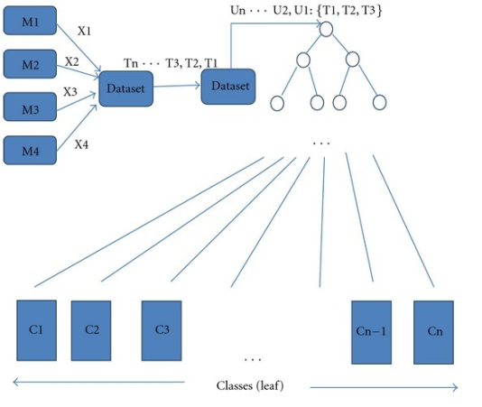
VERY
FAST
DECISION
TREE
Notes:
Introducing: VFDT, a decision-tree learning system that overcomes the shortcomings of incremental algorithms. It is I/O bound, which means it mines examples in less time than it takes to input them from the disk, it’s an anytime algorithm, meaning that the model is ready-to-use at anytime, it does not store any examples and learns by seeing them exactly once.

Slide 5
Hoeffding Decision Tree

Slide 6

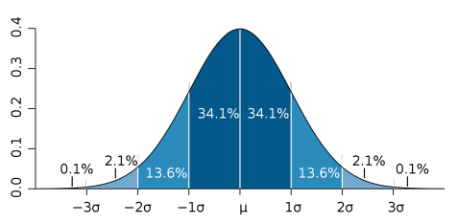
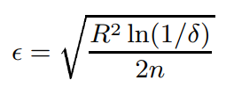
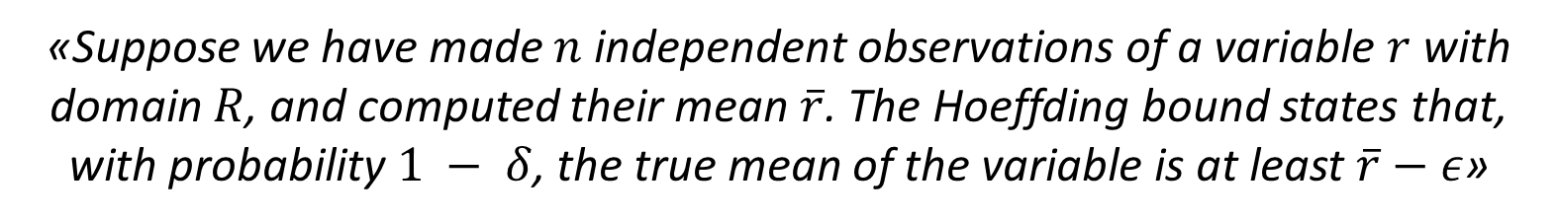
Classical DT learners are limited by main memory size
Probably, not all examples are needed to find the best attribute at a node
How to decide how many are necessary? Hoeffding Bound!
«Suppose we have made $n$ independent observations of a variable $r$ with domain $R$, and computed their mean $\overline{r}$. The Hoeffding bound states that, with probability $1 − δ$, the true mean of the variable is at least $\overline{r}−ε$»
Notes:
Hoeffding Trees are born from the limitations of classical decision tree learners, which assume all training data can be simultaneously stored in main memory. HT is based on the assumption that, in order to find the best attribute at a node, it may be sufficient to consider only a small subset of the training examples that pass through that node. Given a stream of examples, the first ones will be used to choose the root test; once the root attribute is chosen, the succeeding examples will be passed down to the corresponding leaves and used to choose the appropriate attributes there, and so on recursively. We solve the difficult problem of deciding exactly how many examples are necessary at each node by using a statistical result known as the Hoeffding bound.

Slide 7
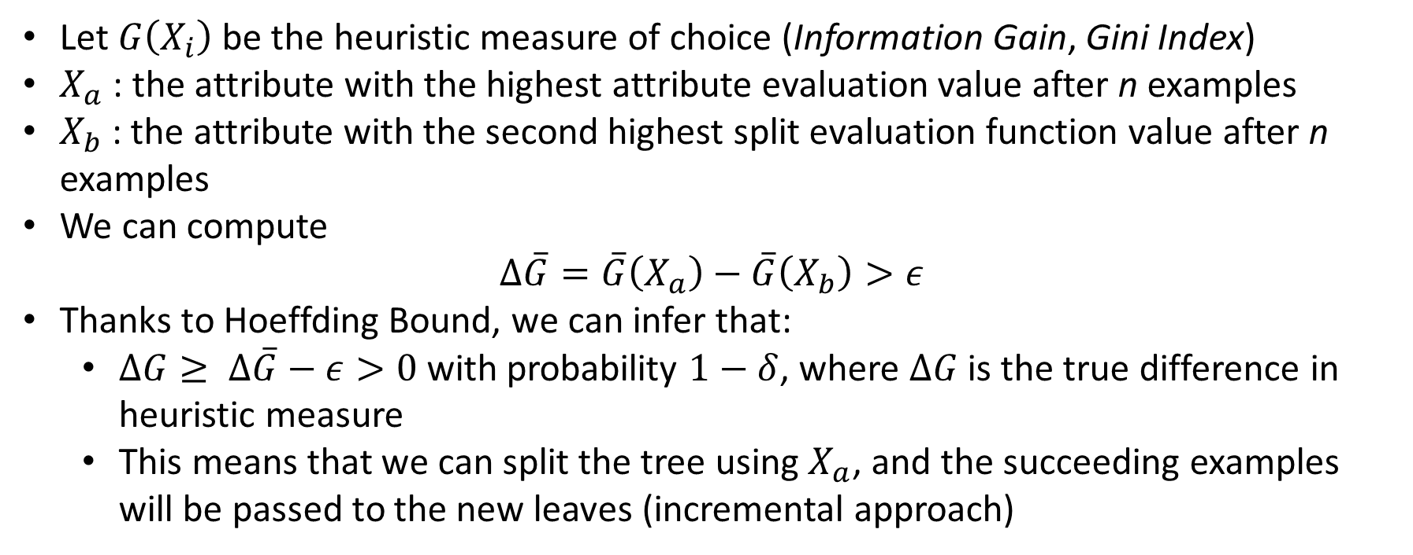
How many examples are enough?
Let $G\left(X_{i}\right)$ be the heuristic measure of choice (Information Gain, Gini Index)
$X_{a}$ : the attribute with the highest attribute evaluation value after n examples
$X_{b}$: the attribute with the second highest split evaluation function value after n examples
We can compute $∆\overline{G}=\overline{G}\left(X_{a}\right)−\overline{G}\left(X_{b}\right)>ε$
Thanks to Hoeffding Bound, we can infer that:
$∆G≥ ∆\overline{G}−ε>0$with probability $1−δ$, where $∆G$ is the true difference in heuristic measure
This means that we can split the tree using $X_{a}$, and the succeeding examples will be passed to the new leaves (incremental approach)
Notes:
So, how do we decide how many examples are enough?

Slide 8
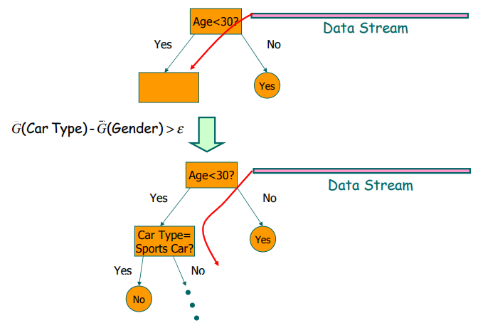
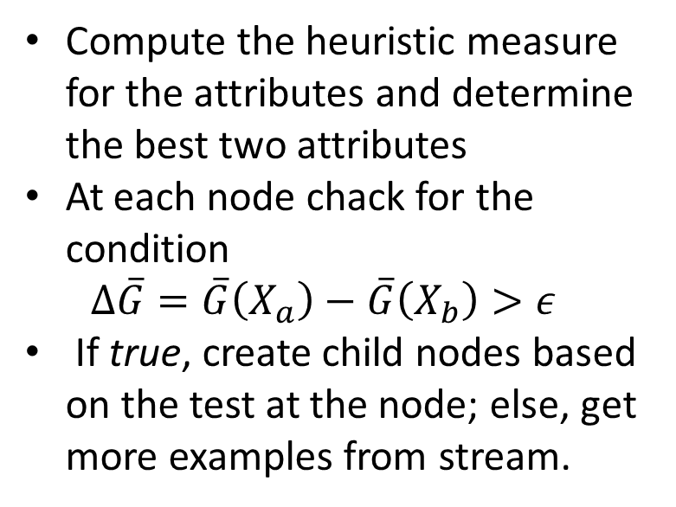
HT Algorithm
Compute the heuristic measure for the attributes and determine the best two attributes
At each node chack for the condition $∆\overline{G}=\overline{G}\left(X_{a}\right)−\overline{G}\left(X_{b}\right)>ε$
If true, create child nodes based on the test at the node; else, get more examples from stream.

Slide 9




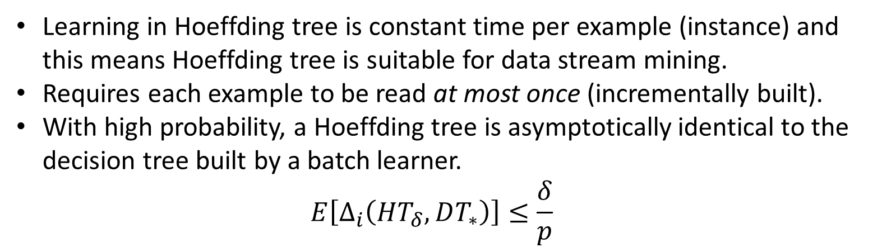
In a nutshell
Learning in Hoeffding tree is constant time per example (instance) and this means Hoeffding tree is suitable for data stream mining.
Requires each example to be read at most once (incrementally built).
With high probability, a Hoeffding tree is asymptotically identical to the decision tree built by a batch learner. $E\left[∆_{i}\left(HT_{δ},DT_{∗}\right)\right]≤\frac{δ}{p}$
goo.gl/gBnm9h
goo.gl/QvZMC7
Independent of the probability distribution generating the observations
Built incrementally by sequential reading
Make class predictions in parallel
What happens with ties?
Memory used with tree expansion
Number of candidate attributes
Notes:
If HTδ is the tree produced by the Hoeffding tree algorithm with desired probability δ given infinite examples (Table 1), DT∗ is the asymptotic batch tree, and p is the leaf probability, then E[∆i(HTδ, DT∗)] ≤ δ/p. The smaller δ/p , the more similar the Hoeffding tree is to a subtree of the asymptotic batch tree.

Slide 10
VFDT

Slide 11
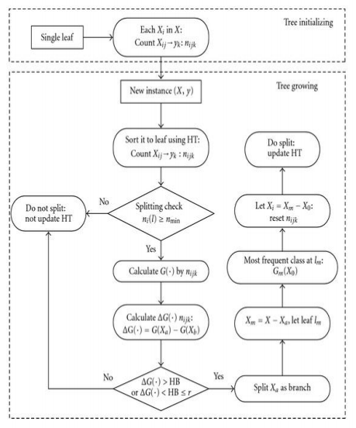
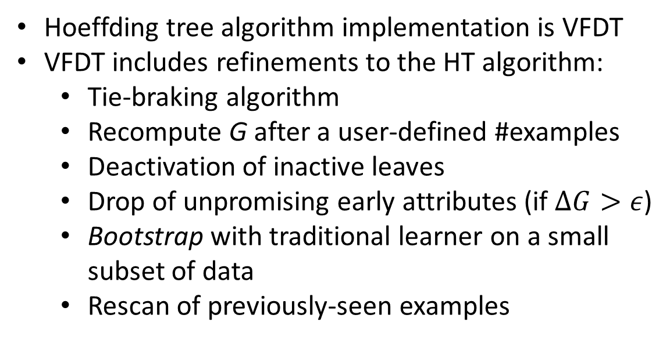
VFDT (Very Fast Decision Tree)
Hoeffding tree algorithm implementation is VFDT
VFDT includes refinements to the HT algorithm:
Tie-braking algorithm
Recompute G after a user-defined #examples
Deactivation of inactive leaves
Drop of unpromising early attributes (if $∆G>ε$)
Bootstrap with traditional learner on a small subset of data
Rescan of previously-seen examples
Notes:
The Hoeffding tree algorithm was implemented into Very Fast Decision Tree learner (VFDT), which includes some enhancements for practical use.
In case of ties, potentially many examples will be required to decide between them with some confidence, which is wasteful since they’re basically equivalent. VFDT splits on the current best attribute.
Recomputing G is actually pretty expensive. In VFDT it is possible to define a parameter for the minimum number of examples read before recomputing G.
Memory was an issue for HT, meaning that the moew the tree grew, the more memory it needed. VFDT deactivates inactive leaves, only keeping track of the probability of x falling into leaf l, times the observed error rate.

Slide 12
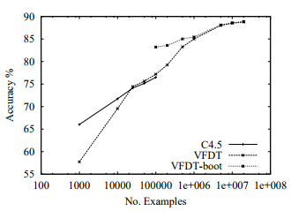
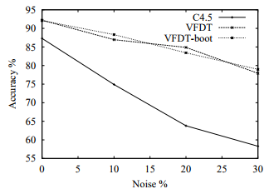
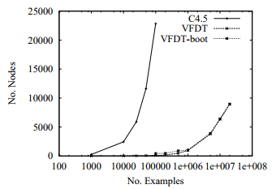

Comparison with C4.5
$$δ={10}^{−7}$$
$$τ=5\%$$ $n_{min}=200$

Slide 13
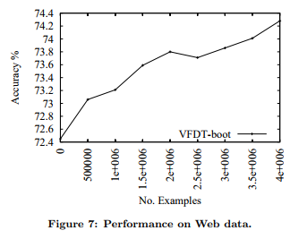
A VFDT application : Web Data
Mining the stream of Web page requests emanating from the whole University of Washington main campus.
Useful to improve Web Caching, by predicting which hosts and pages will be requested in the near future.

Slide 14
Future Work
Test other applications (such as Intrusion detection)
Use of non-discretized numeric attributes
Use of post-pruning
Use of adaptive δ
Compare with other incremental algorithms (ID5R or SLIQ/SPRINT)
Adapt to time-changing domains (concept drift)
Parallelization

Slide 15

QUESTIONS?

Slide 16
THANK YOU!

